Slide 1
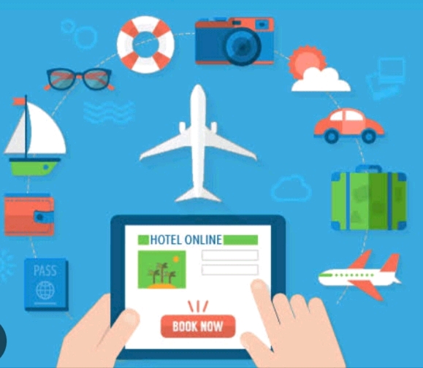
TICKET BOOKING 🎟️
Name: S.Tamilsri
Department:BSC Computer science
Nm id:22922924u18044
College: Sri Bharadhi Woen's Arts and Science

Slide 2
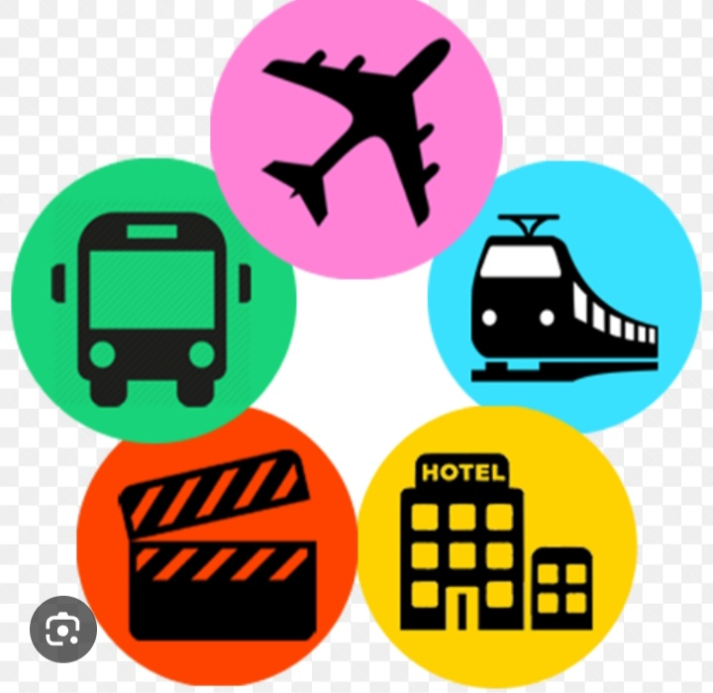
TICKET BOOKING
INTRODUCTION
🎟️Ticket booking systems offer customer convenience through 24/7 online access,
🎟️multiple payment options, and automated processes like confirmations and reminders.

Slide 3

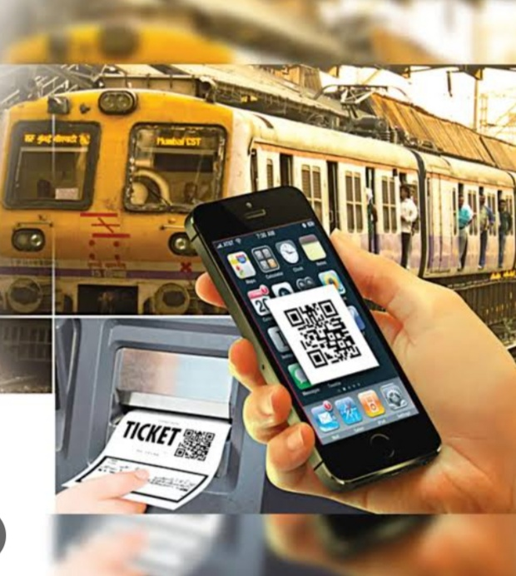

Slide 4
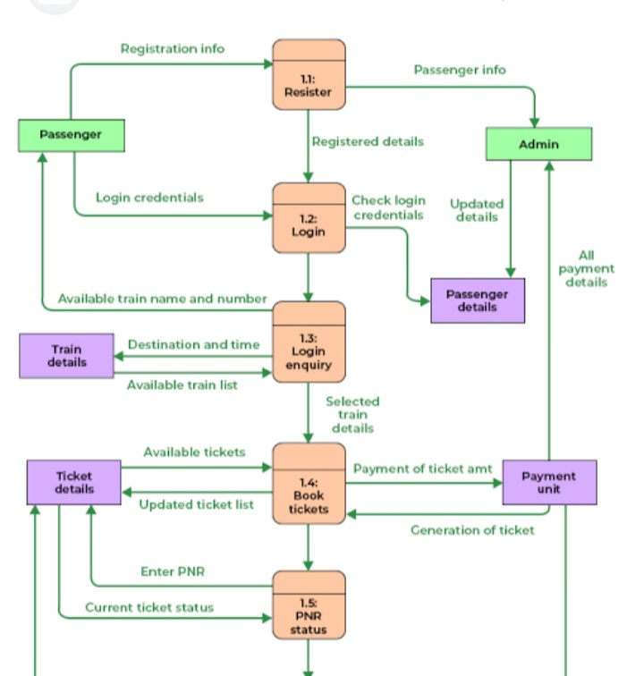

TIKET BOOKING FOR TRAIN
🎟️To book a train ticket online, register for an account on the IRCTC website or app,
🎟️ then log in and search for trains by entering your origin, destination, and travel date.

Slide 5
FEATURES OF TRAIN 🚆 BOOKING
🎟️Ticket Statuses:
Bookings can be confirmed, Reserved Against Cancellation (RAC), or waitlisted, with automatic full refunds for waitlisted tickets in case of train cancellation. 🚆
🎟️In-Train Support:
Features like onboard infotainment services and call buttons for crew service are provided to enhance the passenger experience.🚆

Slide 6
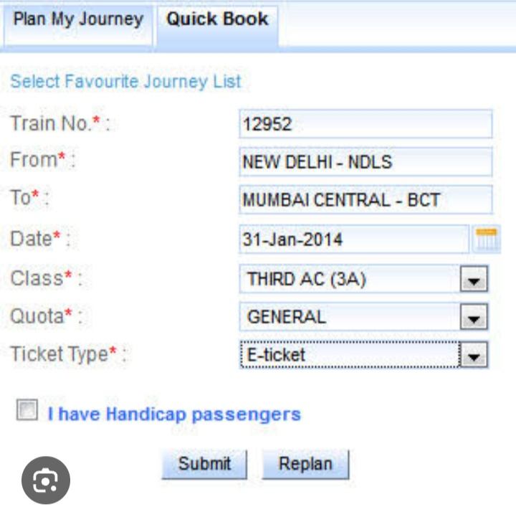
ONLINE TRAIN BOOKING 🚆

Slide 7
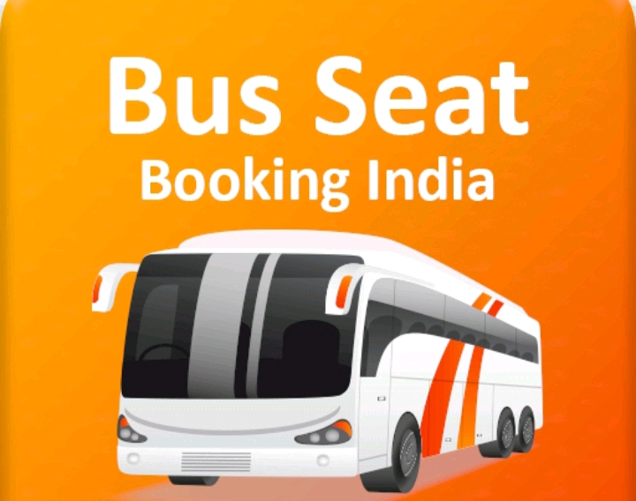

Slide 8
TICKET BOOKING FOR BUS🚌
To book a bus ticket, use a travel website or app, input your origin, destination, and travel date, then select a bus and your preferred seat. Provide passenger and contact details, make the payment, and you'll receive an e-ticket via email or SMS. Remember to choose a bus type that suits your needs, such as AC/Non-AC or sleeper/seater, and always carry a valid government ID with the name matching your ticket.

Slide 9
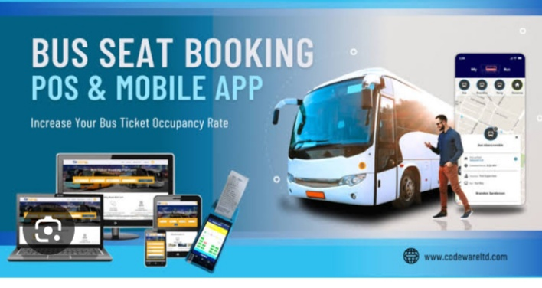
FEATURES OF BUS BOOKING
🎟️Real-Time Seat Selection
🎟️Multiple Payment Options:
🎟️Automated E-Tickets:
🎟️ Booking Management:
🎟️Live Bus Tracking
🎟️24/7 Availability

Slide 10
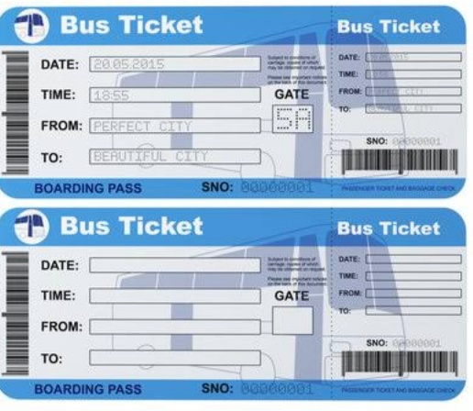
ONLINE TICKET BOOKING 🚌

Slide 11


Slide 12
TICKET BOOKING FOR FLIGHT ✈️
*On the booking platform, input your "from" and "to" cities and your desired travel Date
Select Your Flight: Choose the best flight option based on price, schedule, and airline
Provide Passenger Details: Enter the names and other required information for all travelers.
Choose Add-ons: You may have the option to select seats, add baggage, or opt for travel insurance.
Complete Payment: Se
curely enter your payment information to purchase the ticket.
Confirm Your Booking: You will receive a booking confirmation and the flight ticket itself, usually via email.

Slide 13
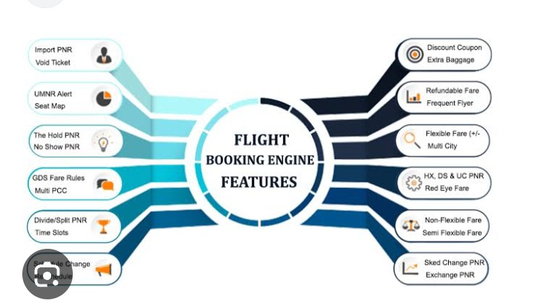
FEATURES OF FLIGHT BOOKING ✈️

Slide 14
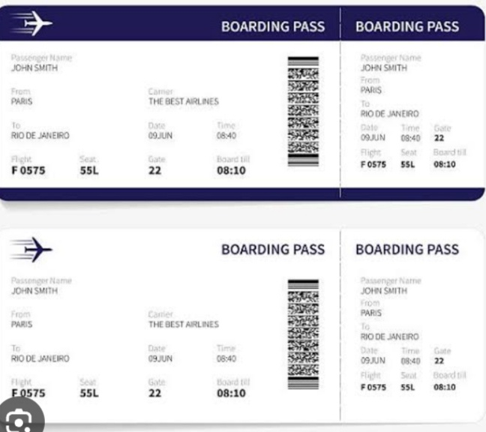
ONLINE TICKET BOOKING ✈️

Slide 15


Slide 16
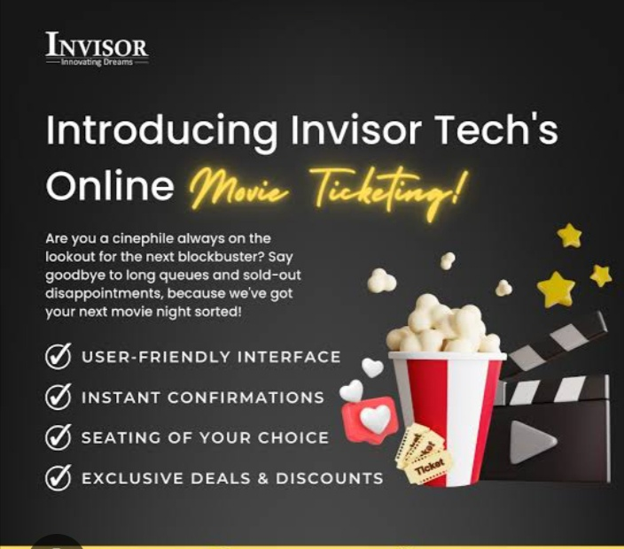
TICKET BOOKING FOR MOVIES 🍿🎦🎬

Slide 17
FEATURES OF BOOKING MOVIE 🍿 TICKETS
Key features of booking movie tickets include browsing listings, interactive seat selection,
various payment options, mobile ticketing with e-tickets, booking management
(like cancellations and refunds), real-time availability updates, and notifications

Slide 18
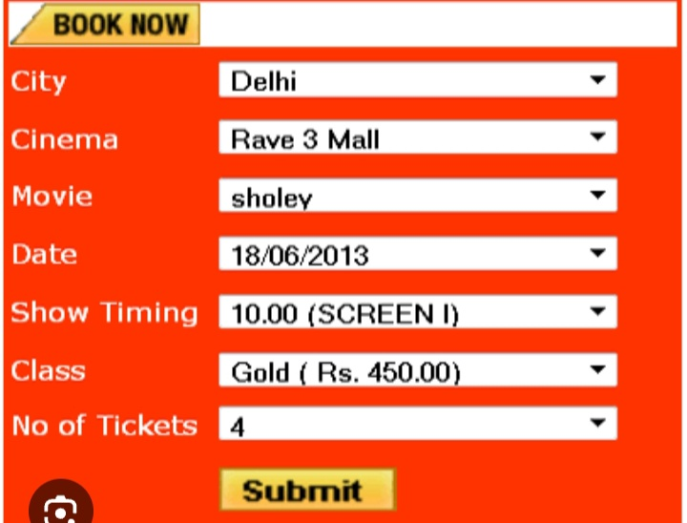
ONLINE TICKET BOOKING FOR MOVIES

Slide 19
CONCLUSION
CONCLUSION
🎟️The conclusion of ticket booking projects emphasizes how automated online systems have successfully reduced
🎟️manual errors,
🎟️increased speed
🎟️ efficiency,
🎟️ improved customer convenience for various services like movies, trains, and buses

Slide 20
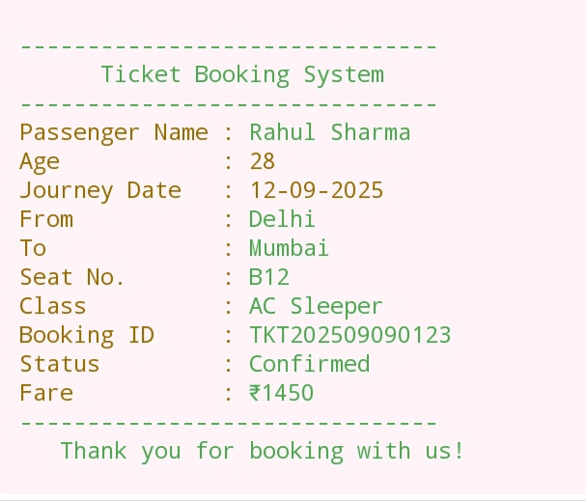
COMMON TICKET BOOKIN SYSTEM

Slide 21
OUTPUT OF TICKET BOOKING
A sample confirmation receipt (like what a passenger sees after booking a train/bus/flight ticket)?
A program output (like what a ticket booking system in Python/Java would print)?
Or a flow/result (like the final status: “Ticket booked successfully”)?

Slide 22
THANK YOU
THANK YOU 👍
Done by :S.Tamilsri

